Slide 1
CREDIT CARD FRAUD DETECTION
Team:-TAMA
Tanal Patel
Abhishek
Maheesh Baijal
Anudeep Verma

Slide 2
Why Is Credit Card Fraud Detection Important?
Credit card fraud is when someone uses another person's credit card or account information to make unauthorized purchases or access funds through cash advances.
Credit card fraud losses reached $28.65 billion worldwide in 2019, according to the most recent Nilson Report data.
The coronavirus pandemic is also fueling explosive growth in card fraud activity.
Credit card fraud impacts consumers, merchants and issuers alike. Its economic cost goes far beyond the cost of illegally purchased merchandise.
Businesses often spend millions to protect themselves from fraud.

Slide 3
Challenges in Credit Card Fraud Detection using ML
Enormous data is being processed every day and the model build must be fast enough to respond to the scam in time.
Imbalanced Data, i.e, most of the transactions (99.9%) are not fraudulent which makes it really hard for detecting the fraudulent ones. The machine learning model tends to be biased towards non-fraudulent transactions.
Much data is not available in the public domain since it involves privacy issues.
Fraudsters try their best to conceal their activities. They use adaptive techniques against the model.

Slide 4
About The Dataset
The data contains 284,807 European credit card transactions with 492 fraudulent transactions that occurred over two days in September 2013.
Except time and amount, everything has been reduced by a Principle Component Analysis (PCA) for privacy concerns. Features V1, V2, ... V28 are the principal components obtained with PCA and have been scaled already.
Since there is little information about the features, we cannot perform much feature engineering and data exploration.
Feature 'Time' contains the seconds elapsed between each transaction and the first transaction in the dataset.
The feature 'Amount'- is the transaction Amount, this feature can be used for example-dependant cost-sensitive learning.
Feature 'Class' is the response variable. It takes value 1 in case of fraud and 0 otherwise.
The dataset is highly unbalanced, the positive class (frauds) account for 0.172% of all transactions.

Slide 5
MODEL EVALUATION METRICS
Accuracy: It is not reliable here as we have a highly skewed dataset. By doing nothing but just predicting everything is in the majority class, we can obtain a very high accuracy of 0.9983.
Precision: true positives / (true positives + false positives)
Recall: true positives / (true positives +false negatives)
F1- score: 2 x Precision x Recall / (Precision + Recall) = 2 x TP / (2 x TP + FP + FN)
A credit card company wants to catch as much fraud as possible (i.e, reduce false negatives; Recall) as fraudulent transactions can be very costly but it also needs to ensure that false alarms are not raised (i.e, reduce false positives; Precision). The credit card company therefore wants to optimize both recall and precision. F1-score takes into account a balance between precision and recall.
Receiver Operating Characteristic Curve(ROC): True positive rate vs. False positive rate at various threshold settings.useful to compare performance of different algorithms for fraud detection.
Area Under the Receiver Operating Characteristic Curve (ROC-AUC): answers the question: "How well can this classifier be expected to perform in general, at a variety of different baseline probabilities?" but precision and recall don't. So it is also a good metric to evaluate the performance of our models.

Slide 6
DATA EXPLORATION

Slide 7
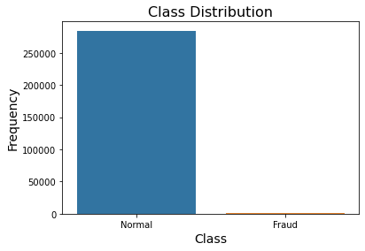
Data Imbalance
There are 284315 normal transactions (99.828%) as opposed to 492 fraud transactions (0.172%). So clearly there is an imbalance in the dataset which may adversely affect the performance of our ML models. Thus we will have to use some techniques to counter this data imbalance

Slide 8
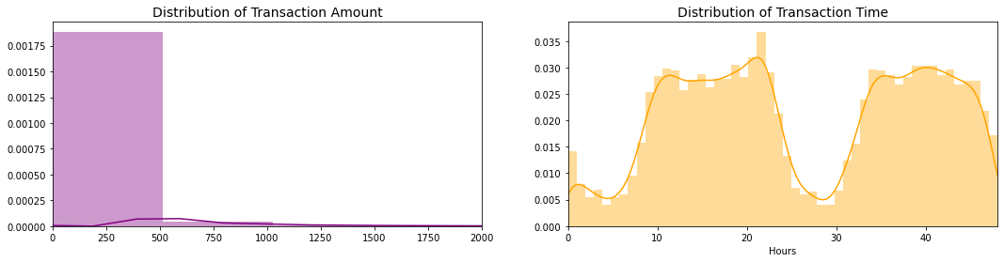
Distribution of Transaction amount and Transaction time
Going by the drop in the amount of transactions at 0 hrs and then again after 24 hrs, we may infer that the it corresponds to night time when people are mostly asleep.
We can say that most of the transactions occurred during the day.
Mean of the transaction amount is 88.35 USD, standard deviation is 250.1 USD and 75%ile is 77.05 USD.

Slide 9
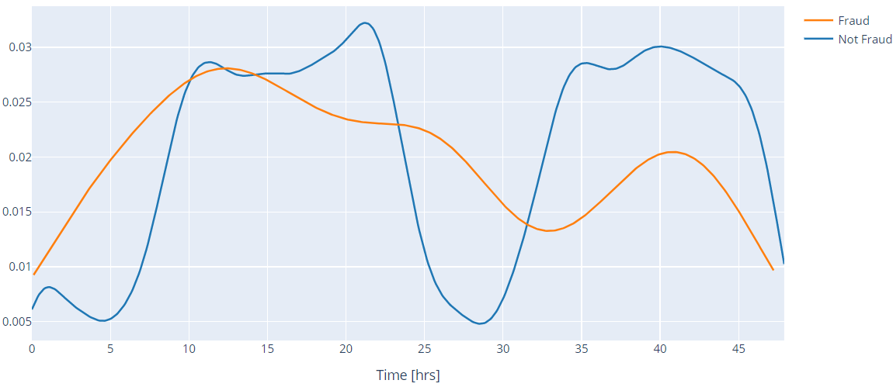
Distribution of Fraudulent and Normal Transactions across time
Now we check if there is some difference between the time of occurrence of normal transactions and fraud transactions
Fraudulent transactions are more equally distributed in time as compared to normal transactions.

Slide 10
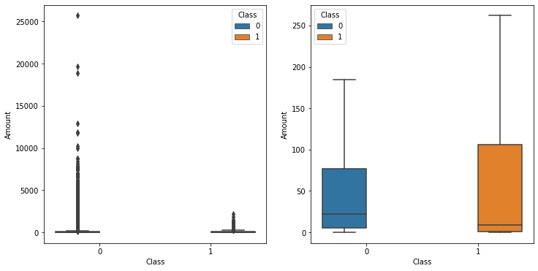
Average Transaction Amounts in each case
The average amount transacted in normal cases is 88.29 USD while in fraud cases, it is 122.21 USD.
Also, from the plot below, we can see that the outliers in case of fraudulent cases are of less amount as compared to normal transactions.

Slide 11
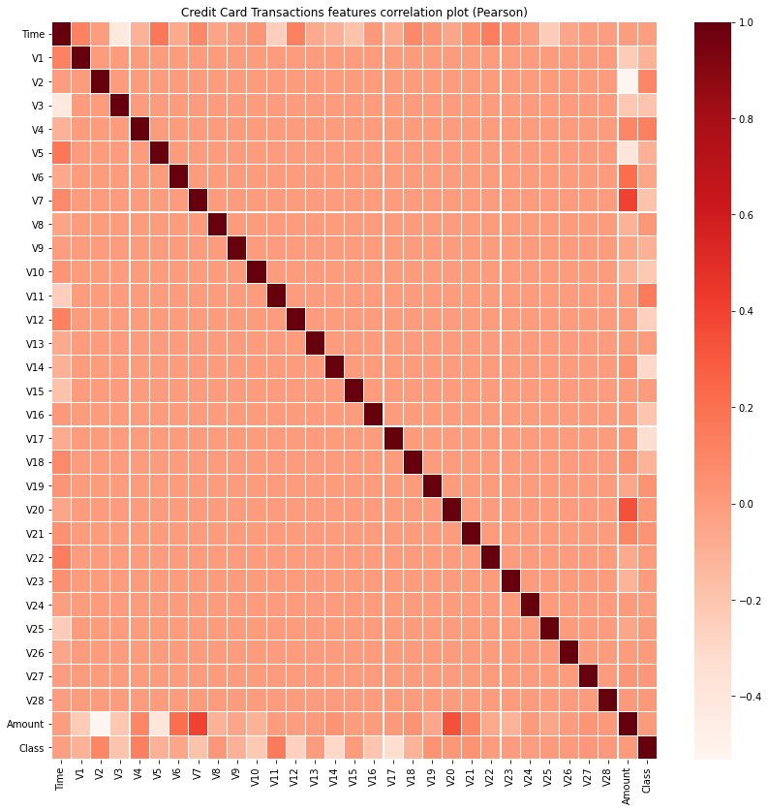
Features Correlation plot
There is no significant correlation between features V1-V28. There are certain correlations between some of these features and Time (negative correlation with V3) and Amount (direct correlation with V7 and V20, negative correlation with V2 and V5). Also there is some negative correlation between V17 and Class.

Slide 12
MODELS USED
LOGISTIC REGRESSION
SUPPORT VECTOR MACHINE (SVM)
ADABOOST
RANDOM FOREST CLASSIFIER
NEURAL NETWORK

Slide 13
Support Vector Machine

Slide 14
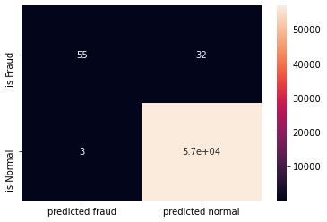
Performance of SVM (with rbf kernel) on test data
Accuracy: 0.9993855
Precision: 0.9483
Recall: 0.6322 (False negatives are high)
F1 score: 0.7586
ROC-AUC score: 0.8161

Slide 15
Random Forest Classifier

Slide 16
Decision Tree
Decision trees with no limit on no. of branches tend to overfit the data as every sample point can be reduced to a leaf i.e, every sample data has its own category. This way decision trees have a very high accuracy on training dataset but fail to replicate on data it had never seen before. But, in this case, the data is already unbalanced and therefore, the accuracy is still high but f1 score is low.
Training data accuracy : 1.0 Training data F1 score : 1.0 Training data AUC score : 1.0
Test Accuracy: 0.99 Test F1 Score: 0.73 Test AUC Score: 0.827
So, to solve the problem of overfitting, one can set limit on number of samples in each leaf and number of branches
Another way of avoiding overfitting is using Random forest.
Random Forest is basically a decision tree algorithm but it uses randomly selected samples from the overall dataset and uses random subsets of features while splitting the nodes. This reduces the possibility of overfitting.

Slide 17
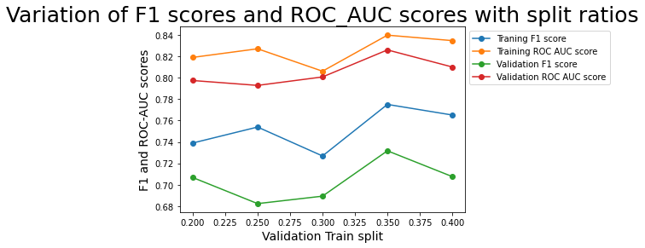
Optimum splitting ratio = 0.35

Slide 18
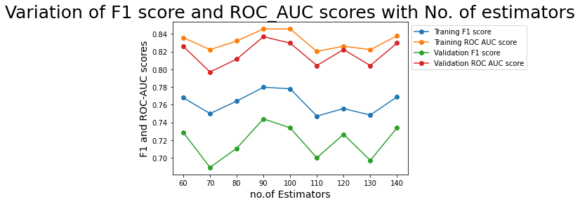
Optimum number of estimators = 90

Slide 19
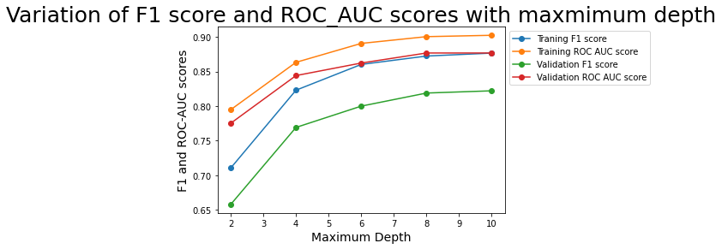
Optimum maximum depth = 10

Slide 20
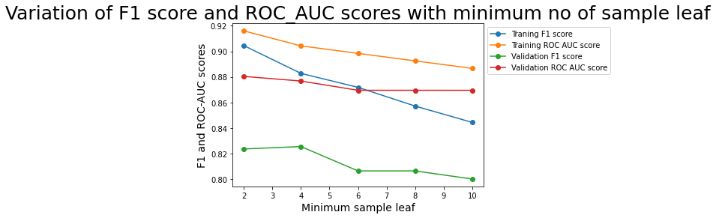
Optimum no. of sample leaf =4

Slide 21
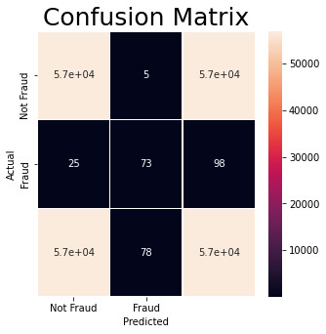
Performance of Random Forest on test data with above values
Test Accuracy: 0.9994733
Precision Accuracy: 0.9359
Recall Accuracy: 0.7449
Test F1 Score: 0.8295
Test AUC Score: 0.8724

Slide 22
ADABOOST

Slide 23
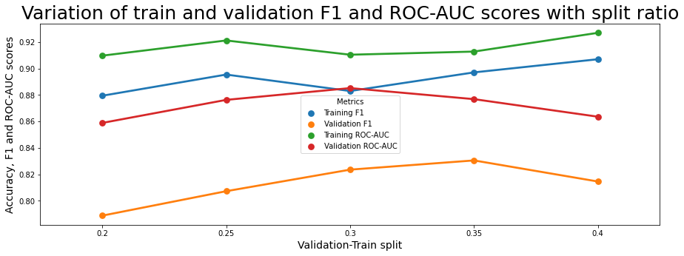
Optimum split ratio = 0.35

Slide 24
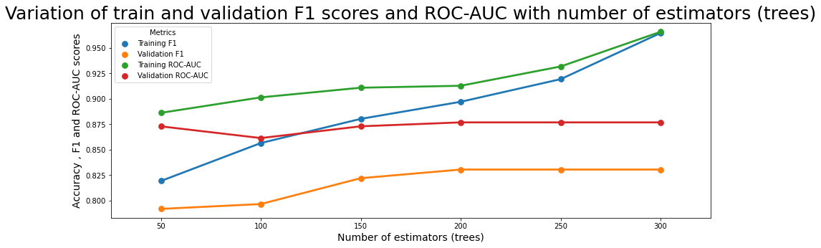
Optimum no. of estimators = 200

Slide 25
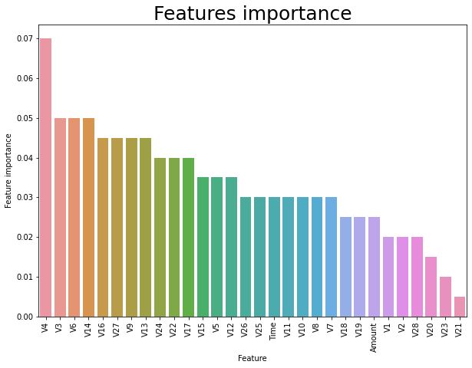

Slide 26
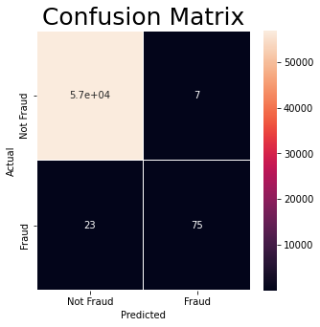
Performance of AdaBoost on test data with above values
Final accuracy= 0.9994733
Final Precision = 0.9146
Final Recall= 0.7653
Final F1 score= 0.8333
Final ROC-AUC= 0.8826

Slide 27
LOGISTIC REGRESSION

Slide 28
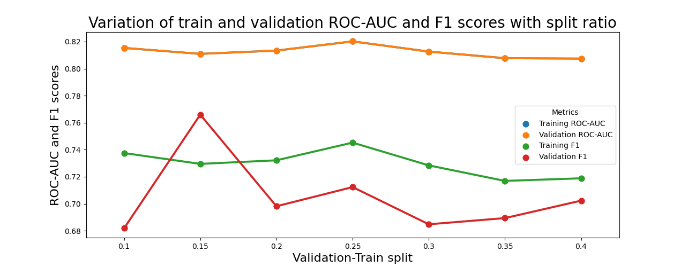
Case 1: When whole data set is used for training
Optimum split ratio = 0.15

Slide 29
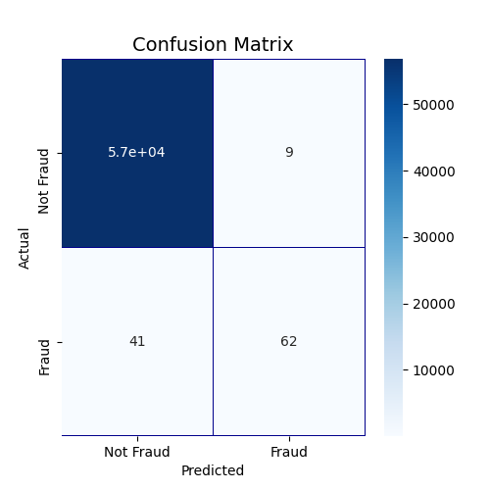
Performance of Logistic Regression on test data with above values
Accuracy : 0.9991
Precision : 0.873
Recall : 0.601 (False negatives are high)
F1 score : 0.7126
ROC-AUC : 0.800

Slide 30
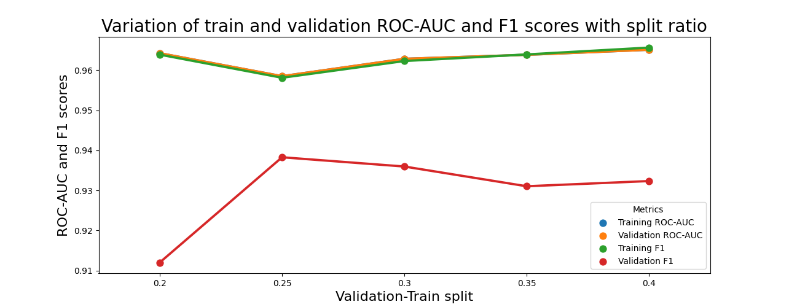
Case 2: When Random Undersampling is used
Optimum split ratio = 0.25

Slide 31
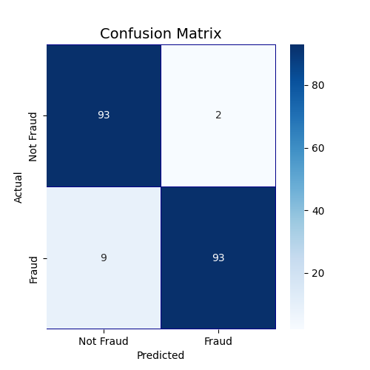
Performance of Logistic Regression on test data with above values
F1 score : 0.944
ROC-AUC : 0.945
Precision : 0.978
Recall : 0.911
Accuracy : 0.944

Slide 32
NEURAL NETWORK

Slide 33
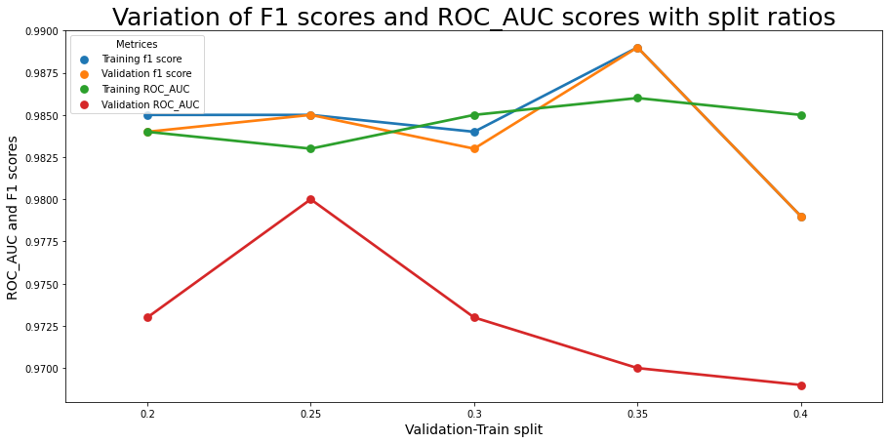
Optimum Split ratio = 0.35

Slide 34
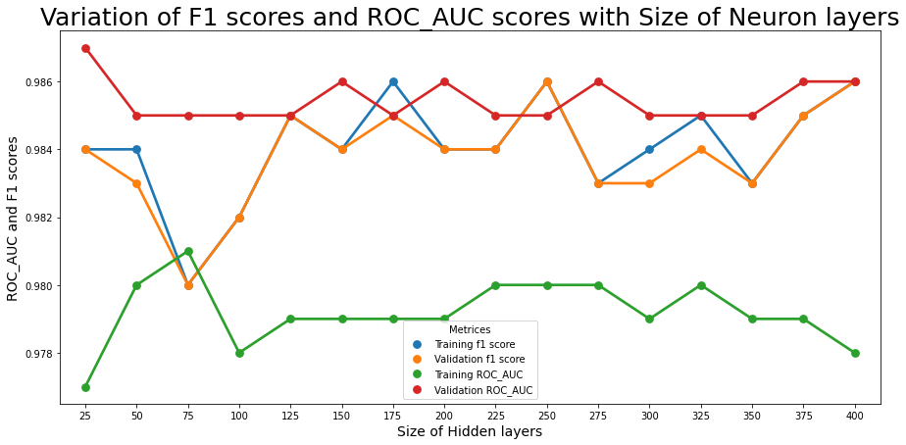
Optimum Hidden layer size = 250

Slide 35
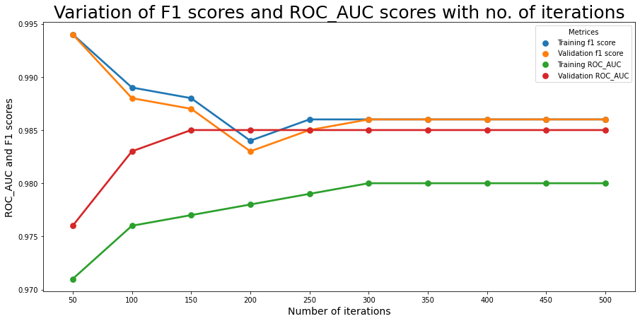
Optimum iterations = 400

Slide 36
Different Activation function
Rectified Linear Activation (ReLU)
Precision = 0.998
Recall = 0.977
f1 score = 0.987
ROC_AUC = 0.986
Hyperbolic Tangent (Tanh)
Precision = 0.998
Recall = 0.97
f1 score = 0.983
ROC_AUC = 0.984
Logistic (sigmoid)
Precision = 0.9984
Recall = 0.9701
f1 score = 0.9834
ROC_AUC = 0.9842
Optimum Activation function = ReLU

Slide 37
Different Solvers
Adam
Precision = 0.9984
Recall = 0.9771
f1 score = 0.987
ROC_AUC = 0.9861
Stochastic Gradient Descent
Precision = 0.999
Recall = 0.9986
f1 score = 0.9987
ROC_AUC = 0.9826
Light- memory BFGS
Precision = 0.9984
Recall = 0.901
f1 score = 0.9464
ROC_AUC = 0.937
Optimum Solver = SGD

Slide 38
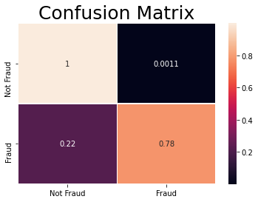
Performance of Neural Network on test data with above values
Accuracy = 0.9986
Precision = 0.9989
Recall = 0.9986
f1 score = 0.9987
ROC_AUC = 0.9576

Slide 39
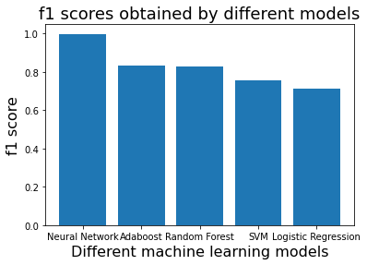
Comparing models on the basis of f1 score on test data
Neural Network (0.9987)
AdaBoost (0.8333)
Random Forest (0.8295)
SVM (0.7586)
Logistic Regression (0.7126)

